Slide 1
R.S.F Doping in Sports
By Dr. KWIHANGANA Prosper

Slide 2
AGENDA
Introduction
Definition
Why people dope?
Doping’s several effects
Male and female effects
Example case
Why Anti-Doping Matters
Key Principles of Anti-Doping
Conclusion

Slide 3
INTRODUCTION
Sports can teach to young adults so many valuable Lessons :
1 the value of had work, teamwork, dealing with focus , consistency and on and on .
2 to have this undermined by doping among those athletes we most admire alone makes doping unacceptable
It is cheating , pure and simple ,and that is wring

Slide 4
Doping is:
A drug taken by an athlete to improve performance
Anabolic steroids
Blood booster such as erythropoietin
Beta blockers

Slide 5
Why people dope
Training effect
Artificially enhancement
Exerts a therapeutic effect
Develop physiques that stretch limits

Slide 6
Doping’s several effects
Premature heart disease
Mood disorders or roid rage
Hepatocellular Damage
Cardiovascular disease
It also can lead to some cancers

Slide 7
Doping’s several effects (2)
Arrhythmia
Psychological Disturbance
Musculoskeletal effects
Increased mortality

Slide 8
Male and female effects
Male
Female
Impotence with chronic or repeated use.
There testicular starts to shrink.
They start to get a breast enlargement.
They also start to have a prostatic enlargement.
Reduction of sperm production
Lastly, premature baldness
They start to look manlier, or masculinization/ hirsutism.
Start to grow excessive hair growth on the face & body
Abnormal menstrual cycles
Their breast starts to reduce in size.
There vocal cords start to thicken which causes the deepening of the voice
Some women get polycystic ovarian syndrome, which is a genetic disease

Slide 9
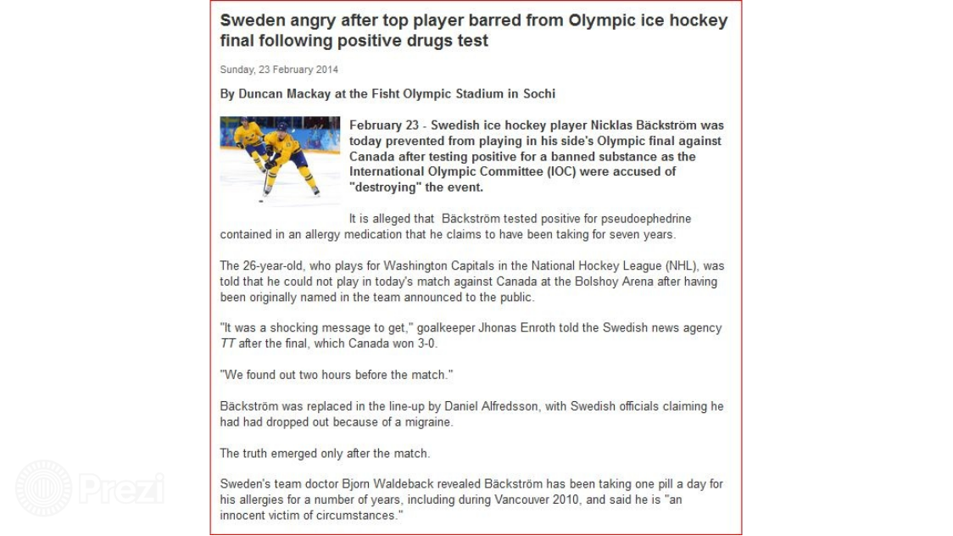
Example

Slide 10
Why Anti-Doping Matters:
Fair Play: Anti-doping measures ensure that all athletes compete on an equal footing, without the influence of performance-enhancing substances.
Health and Safety: Athletes' well-being is safeguarded by preventing the use of harmful substances that can have serious health consequences
Integrity of Sport: Upholding anti-doping principles maintains the credibility of sports, encouraging trust from fans, sponsors, and the broader community.
Preserving Olympic Values: Anti-doping aligns with the Olympic spirit of promoting excellence, respect, and friendship through clean competition.

Slide 11
Key Principles of Anti-Doping:
Prohibition: The World Anti-Doping Agency (WADA) establishes a list of prohibited substances and methods that athletes must avoid.
Testing: Athletes undergo random and targeted drug tests to detect the presence of banned substances.
Therapeutic Use Exemptions (TUEs): Athletes with legitimate medical needs can apply for permission to use prohibited substances if medically necessary
Education: Comprehensive education programs ensure that athletes, coaches, and support staff are aware of anti-doping rules and the risks associated with doping
Sanctions: Those who violate anti-doping rules face consequences, including suspension and disqualification from competition

Slide 12
The Role of the Rwanda Swimming Federation:
Education and Awareness: Implement a robust anti-doping education program to ensure all athletes and stakeholders are informed about the risks, rules, and consequences of doping
Collaboration: Work closely with national and international anti-doping organizations to ensure compliance with regulations and effective testing procedures.
Testing Protocols: Establish clear guidelines for drug testing during competitions and training periods to maintain a high level of transparency and fairness.
Support for Clean Athletes: Provide resources and support to athletes who prioritize clean competition, including guidance on legal supplements and safe training practices

Slide 13
Conclusion:
Anti-doping efforts are essential for maintaining the integrity of sports and upholding the values of fair play, health, and competition.
The Rwanda Swimming Federation plays a critical role in educating athletes, coaches, and stakeholders about anti-doping rules and ensuring compliance.
By working together, we can create a clean and transparent sports environment that inspires pride, trust, and excellence in Rwandan swimming.

Slide 14
Thank you for your attention.
Let's join hands to promote clean sports and uphold the true spirit of competition!

